Slide 1
Introduction to Linear Regression
Elliot Orenstein
05/25/2022

Slide 2
Introduction
What do all these questions have in common?
What is the impact of a car’s horsepower on its fuel efficiency?
How does weather affect the number of bikes rented in London?
What is the predicted value of a 1,500 sq. ft. house?
They may all be modeled with linear regression!
Notes:
Should I start off with multiple or just say I’m doing simple?

Slide 3
Objectives of today’s lesson
1
Define linear regression and understand when to use it
2
Discuss the math behind the model
3
Interpret and predict
4
Fit a linear regression to a real-world dataset
5
Weigh the pros and cons of linear regression

Slide 4
Criteria for linear regression
Linear regression models how a dependent variable (response) varies with respect to independent variables (predictors). We can use it when:
The relationship between the predictors and response is linear
The response is numeric (i.e., not categorical)
Observations are independent from one another
There may be some random noise (error) in the relationship (more on these assumptions next class)
Today, we’ll focus on linear regressions involving a single predictor. These models are also known as simple linear regression.
Notes:
Use house example

Slide 5
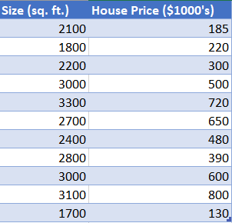
The setup
1
2
3
4
5
We have n observations in the form:
(x₁, y₁), (x₂, y₂), …, (x_{n}, y_{n}) where x_{i} is the predictor of the i^{th} observation and y_{i} is the corresponding numeric response.
Based on scatterplots and context, we assume the relationship is linear.
x₁
y₁
x_{n}
y_{n}
Notes:
Split up this slide and include visuals

Slide 6
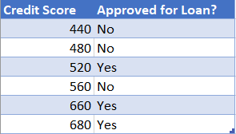
Activity
1
2
3
4
5
Determine what is and isn’t suitable for simple linear regression
X
X
✓
Notes:
Quadratic, classification, negative slope, severe outliers?

Slide 7

Modeling a relationship as a linear regression
Background: A line (y = mx + b) is defined by its slope (m) and y-intercept (b)
The linear relationship between the predictor and response is modeled as
y = β₀ + β₁x
ε
β₀ is the true, unknown y-intercept
β₁ is the true, unknown slope
ε_{i} is the error (a random variable with assumptions that we’ll discuss later)
In other words, this model states that there is a linear relationship between the predictor (size) and the response (house price), but we may see some random deviations
Notes:
Add animations and fix error

Slide 8

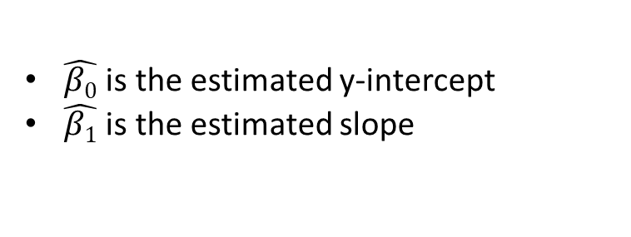
Estimating the linear relationship
We’re interested in finding the linear relationship between the variables, despite the noise.
Using the data provided, we can estimate what that is!
All estimator lines have the form:
Estimator 2
Estimator 1
Estimator 3
$\hat{β\text{0}}$ is the estimated y-intercept
$\hat{β\text{1}}$ is the estimated slope
But there are an infinite number of estimates we could make, so:
How do we measure the quality of our estimates?
And once we know how to compare our estimates, how do we find the best one?
Notes:
Split up this slide and include visuals, intro lobf

Slide 9

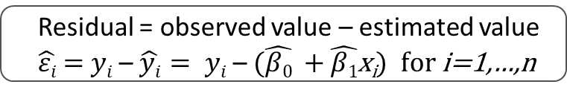



Residuals are a measure of estimation error
Definition
Residual = observed value – estimated value
$\hat{εi}$ = $yi$ – $\hat{yi}= yi$ –$(\hat{β\text{0}}$ + $\hat{β\text{1}}$x_{i}) for i=1,…,n
Data observation #1
Estimator 1
Observed point: (2100, 185)
$\hat{y}= \hat{β\text{0}}$ + $\hat{β}1$x
Estimated point: (2100, $\hat{β\text{0}}$ + $\hat{β}1$ $×$2100 ≈ 275)
Residual: $\hat{εi}$ = $yi$ – $\hat{yi}$= 185 – 275 = –90
$\hat{ε1}$
Residuals can be positive, negative, or zero
*Zoomed in for illustration
Notes:
We made this line

Slide 10
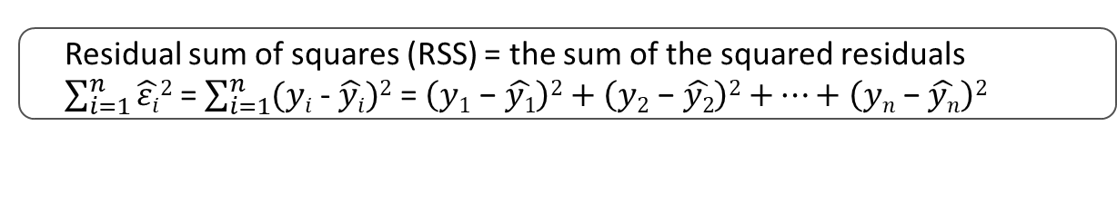






Choose the line that minimizes the residual sum of squares
Definition
Residual sum of squares (RSS) = the sum of the squared residuals $\sum_{i=1}^{n}{\hat{εi}2}$= $\sum_{i=1}^{n}{(yi\text{ - }\hat{yi})2}$ = $\left(y1\text{ − }\hat{y1}\right)2$ $+$ $\left(y2\text{ − }\hat{y2}\right)2$ $+⋯+\left(yn\text{ − }\hat{yn}\right)2$
Estimator 2
Estimator 1
$\hat{ε10}$
$\hat{ε10}$
$\hat{ε2}$
$\hat{ε2}$
$\hat{ε1}$
$\hat{ε1}$
Estimating the unknown slope and y-intercept of our linear regression model by minimizing the RSS is called the ordinary least squares (OLS) method.
Notes:
Fix animation, explain summation notation and write it,

Slide 11
How to use your model
You’ve found your “line of best fit.” What now?
General questions
Questions related to our example
Interpret
What do the coefficients mean in the context of my problem?
How much does house price change for every additional square foot?
Predict
How can I use my linear regression model to predict on new data?
What can I expect the price of a 2,600 sq. ft. house to be?

Slide 12

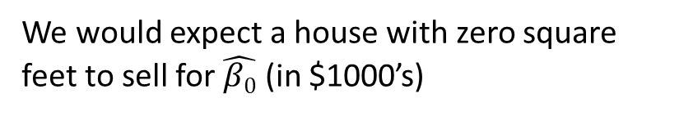
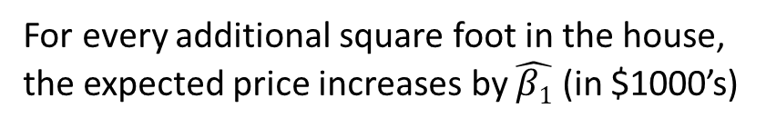
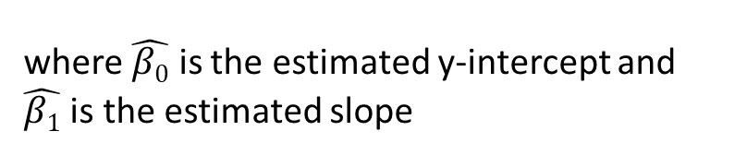

Interpreting the coefficients
Recall that our “line of best fit” has the form
where $\hat{β\text{0}}$ is the estimated y-intercept and $\hat{β\text{1}}$ is the estimated slope
General interpretations
Interpretations related to our example
$\hat{β\text{0}}$
The expected value of our response when x=0
We would expect a house with zero square feet to sell for $\hat{β0}$ (in $1000’s)
How much the response changes (increases if +, decreases if -) for every additional unit of the predictor
For every additional square foot in the house, the expected price increases by $\hat{β1}$ (in $1000’s)
$\hat{β1}$

Slide 13
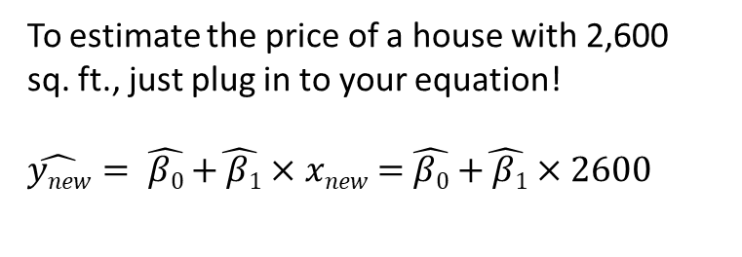
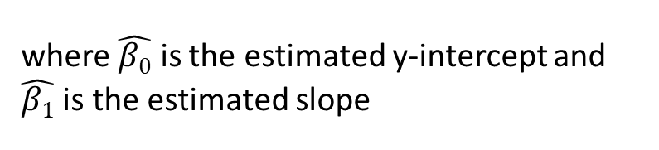
Predicting responses from new data
Recall that our “line of best fit” has the form
where $\hat{β\text{0}}$ is the estimated y-intercept and $\hat{β\text{1}}$ is the estimated slope
Mathematically
Graphically
To estimate the price of a house with 2,600 sq. ft., just plug in to your equation!
$\hat{ynew}$ $= \hat{β\text{0}}$ $+\hat{ β\text{1}}×$ $xnew$ $=$ $\hat{β\text{0}}$ $+\hat{ β\text{1}}×$ $2600$ ≈ 275
Line of Best Fit
Estimating the price of a house with 2,600 sq. ft.
Notes:
Can I cut words here?

Slide 14
A real-world example
Let’s look at data from London bike rentals in a Jupyter notebook!
Notes:
https://scikit-learn.org/stable/modules/generated/sklearn.linear_model.LinearRegression.html

Slide 15
Advantages and disadvantages of simple linear regression
Advantages
Disadvantages
Highly interpretable and intuitive
Low level of complexity
Fundamental method that many others rely on
Potential to have better predictive power and mitigate disadvantages when combined with other methods
Sensitive to outliers
Requires many assumptions on the error and observations
Often this approach over-simplifies the problem

Slide 16

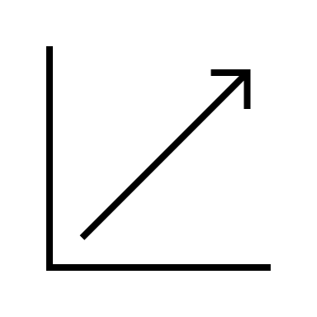


Summary
Linear regression is a fundamental tool for modeling relationships between independent and dependent variables.
It assumes a linear relationship between variables and uses the given observations to find the best estimate known as the “line of best fit.”
A linear regression model provides interpretations of the relationship between the variables and allows us to make predictions on new data.
While it’s highly interpretable and intuitive, it is susceptible to outliers and is limited to linear relationships.
Notes:
Briefly discuss

Slide 17
Next class
Solving OLS using calculus
Assumptions on the error
Diagnostic tests to check these assumptions

